Slide 1
Employee Data Analysis using Excel
STUDENT NAME: SESUMARY F
REGISTER NO : 2201111036067
NM ID : 3FFBFF5BC0882D4A9D24559A0F19E15C
DEPARTMENT : COMMERCE (GENERAL)
COLLEGE : L.N.G.COLLEGE(A),PONNERI-601204.

Slide 2
PROJECT TITLE
Employee Performance Analysis using Excel

Slide 3


AGENDA
Problem Statement
Project Overview
End Users
Our Solution and Proposition
Dataset Description
Modelling Approach
Results and Discussion
Conclusion
3/21/2024 Annual Review

Slide 4

PROBLEM STATEMENT
The project involves analyzing employee performance data using Excel to identify trends, strengths, and areas for improvement. The goal is to develop a clear understanding of individual and team performance metrics, enabling data-driven decisions for optimizing productivity and employee development.

Slide 5

PROJECT OVERVIEW
The "Employee Performance Analysis" project using Excel involves evaluating and monitoring employee performance metrics to enhance productivity and decision-making. The project includes data collection on key performance indicators (KPIs) such as attendance, task completion rates, sales figures, and customer feedback. Excel is utilized to organize, analyze, and visualize this data through charts, pivot tables, and dashboards. The analysis helps identify top performers, areas needing improvement, and trends over time, ultimately supporting informed management decisions and improving overall organizational efficiency.

Slide 6


WHO ARE THE END USERS?
*HR Managers*: They use the analysis to assess employee performance, plan training, and development programs, and make decisions about promotions or disciplinary actions.
*Department Heads and Team Leaders*: They review the data to manage team performance, set targets, and identify areas for improvement.
*Executives and Senior Management*: They use the insights to make strategic decisions related to workforce management, resource allocation, and overall company performance.
*Employees*: In some cases, employees may also access performance reports to understand their own performance metrics and areas for growth.

Slide 7

OUR SOLUTION AND ITS VALUE PROPOSITION
Data Collection and Organization: Compile employee performance data into structured Excel sheets to ensure accurate tracking and analysis. This provides a centralized view for easier management and evaluation.
Performance Metrics Calculation: Use Excel formulas to calculate key performance indicators (KPIs) like productivity, efficiency, and goal achievement. This quantifies performance objectively for better insights.
Visual Reporting: Create charts and graphs to visualize performance trends and comparisons. This enhances understanding and communication of performance results to stakeholders.
Trend Analysis and Forecasting: Leverage Excel’s analytical tools to identify performance trends and predict future outcomes. This aids in strategic planning and proactive decision-making.

Slide 8
Dataset Description
Employee ID: Unique identifier assigned to each employee for precise tracking.
First Name: Employee’s first name for personal identification.
Last Name: Employee’s last name for complete identification.
Email: Contact email address of the employee for communication.
Business Unit: Specific division or department the employee belongs to.
State: Geographic location or state where the employee is based.
Job Function: The role or function the employee performs within the organization.
Gender: Gender of the employee for demographic analysis.
Performance Score: Numerical score reflecting the employee’s performance level.
Current Employee Rating: Current rating or evaluation of the employee’s performance.

Slide 9

THE "WOW" IN OUR SOLUTION
Holistic View: Aggregates key employee details—such as business unit, job function, and performance score—into one cohesive analysis, enabling targeted insights and strategic decisions.
Customizable Analysis: Allows for tailored reporting by filtering and segmenting data based on specific criteria like department, location, or performance score, thus providing a flexible and detailed performance evaluation tool.
3/21/2024 Annual Review
9

Slide 10
MODELLING
Data Filtering: This involves using Excel’s filtering tools to view specific subsets of data. You can filter data based on criteria like date ranges, performance metrics, or department. This helps in narrowing down to relevant information, making it easier to analyze performance trends and identify key areas of focus.
Pivot Tables: Pivot tables are a powerful feature for summarizing and analyzing large datasets. You can create pivot tables to aggregate data, such as total sales per employee, average performance scores, or monthly productivity. Pivot tables allow you to quickly rearrange and analyze data by dragging and dropping fields, which provides flexible and dynamic views of employee performance.
Conditional Formatting: This technique highlights cells that meet specific criteria, such as performance scores above a certain threshold. By applying conditional formatting, you can visually distinguish high and low performers, making it easier to identify trends and outliers in your data.
Charts and Graphs: Visualizing data through charts and graphs can provide clear insights into performance metrics. Bar charts, line graphs, and pie charts can illustrate trends over time, comparisons between employees, or distribution of performance scores, enhancing the overall understanding of the data.
10

Slide 11
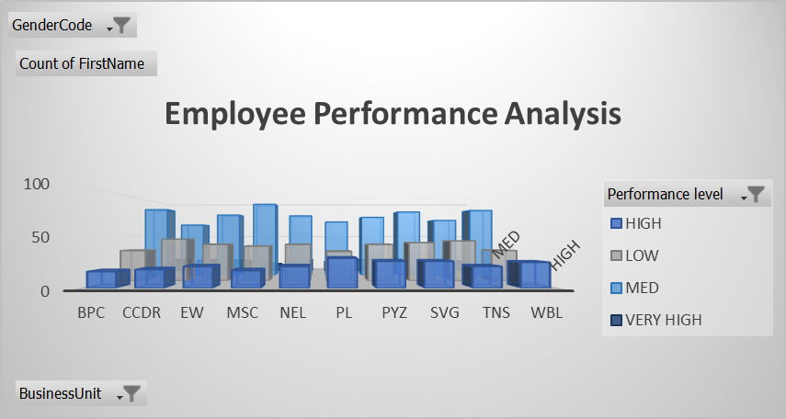
RESULTS
11

Slide 12
conclusion
The project “Employee Performance Analysis Using Excel provides a solution is large number of employees falling into the medium-performance category suggests that the performance distribution is relatively balanced. This might indicate that while some employees are performing at a high level and others at a low level, most employees are delivering average results. Investigate factors that could be contributing to the medium performance levels. This could include work environment, resources, or management practices. Addressing these factors could help in improving overall employee performance.

